Slide 1





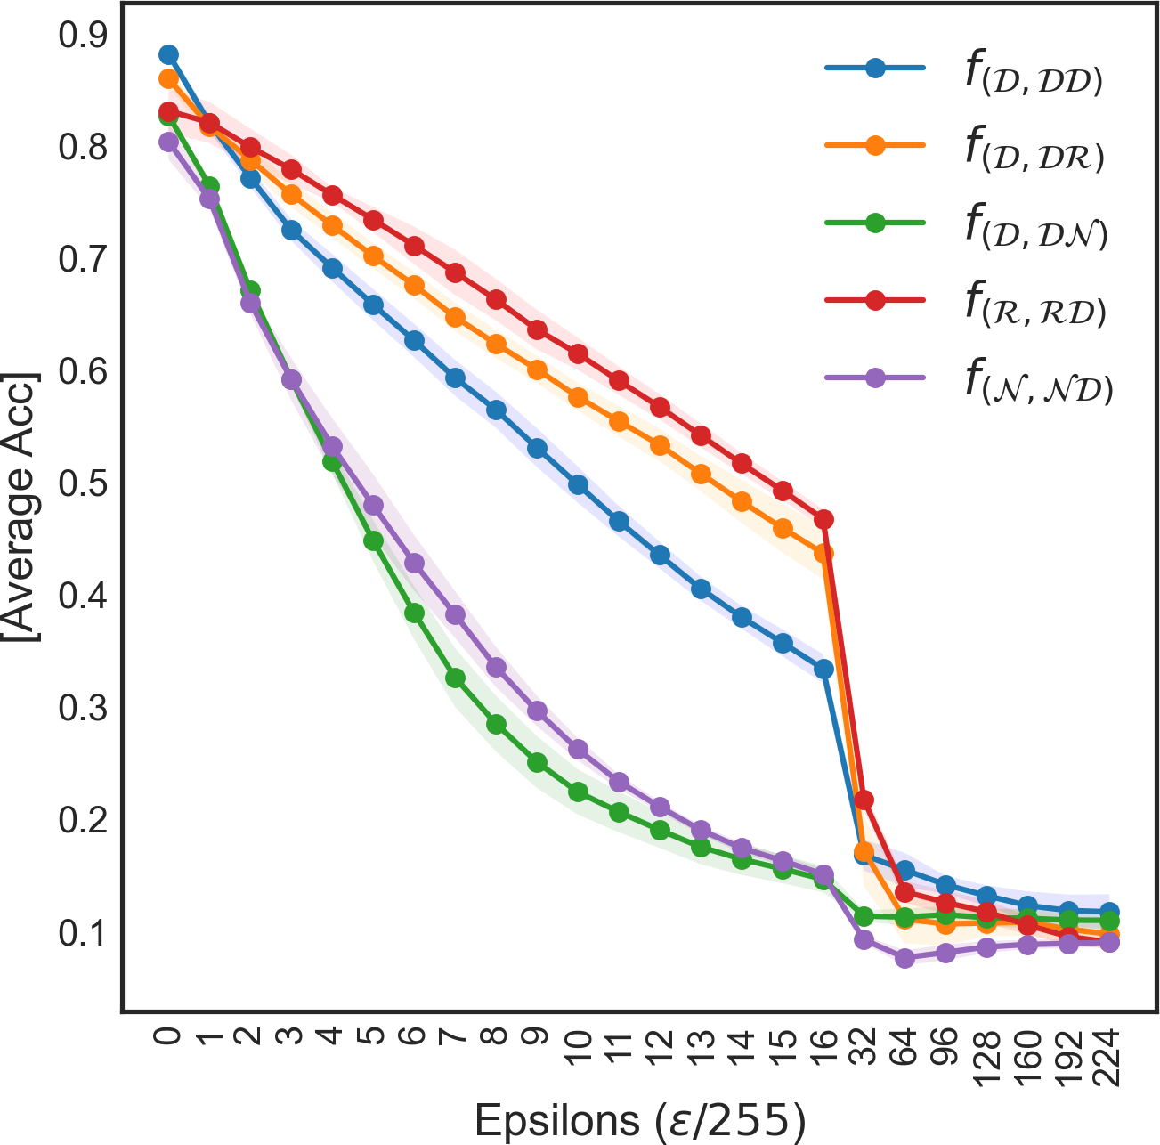
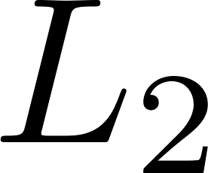
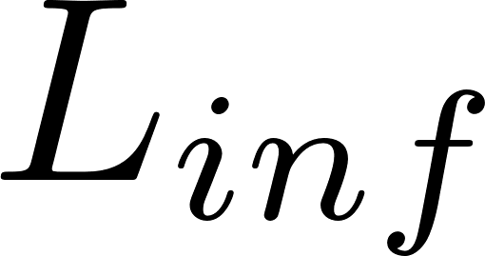
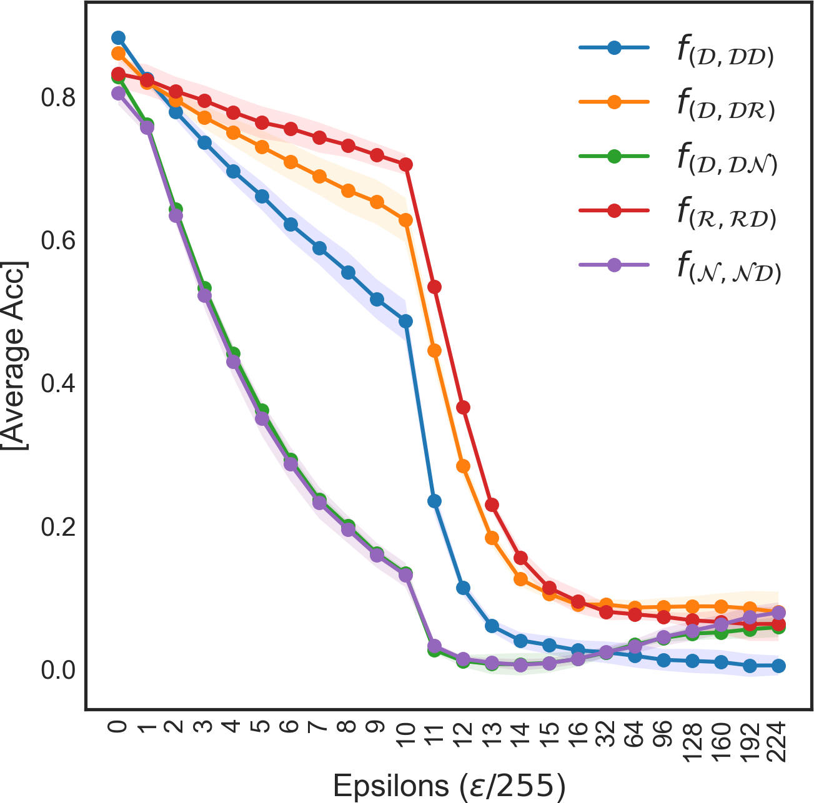
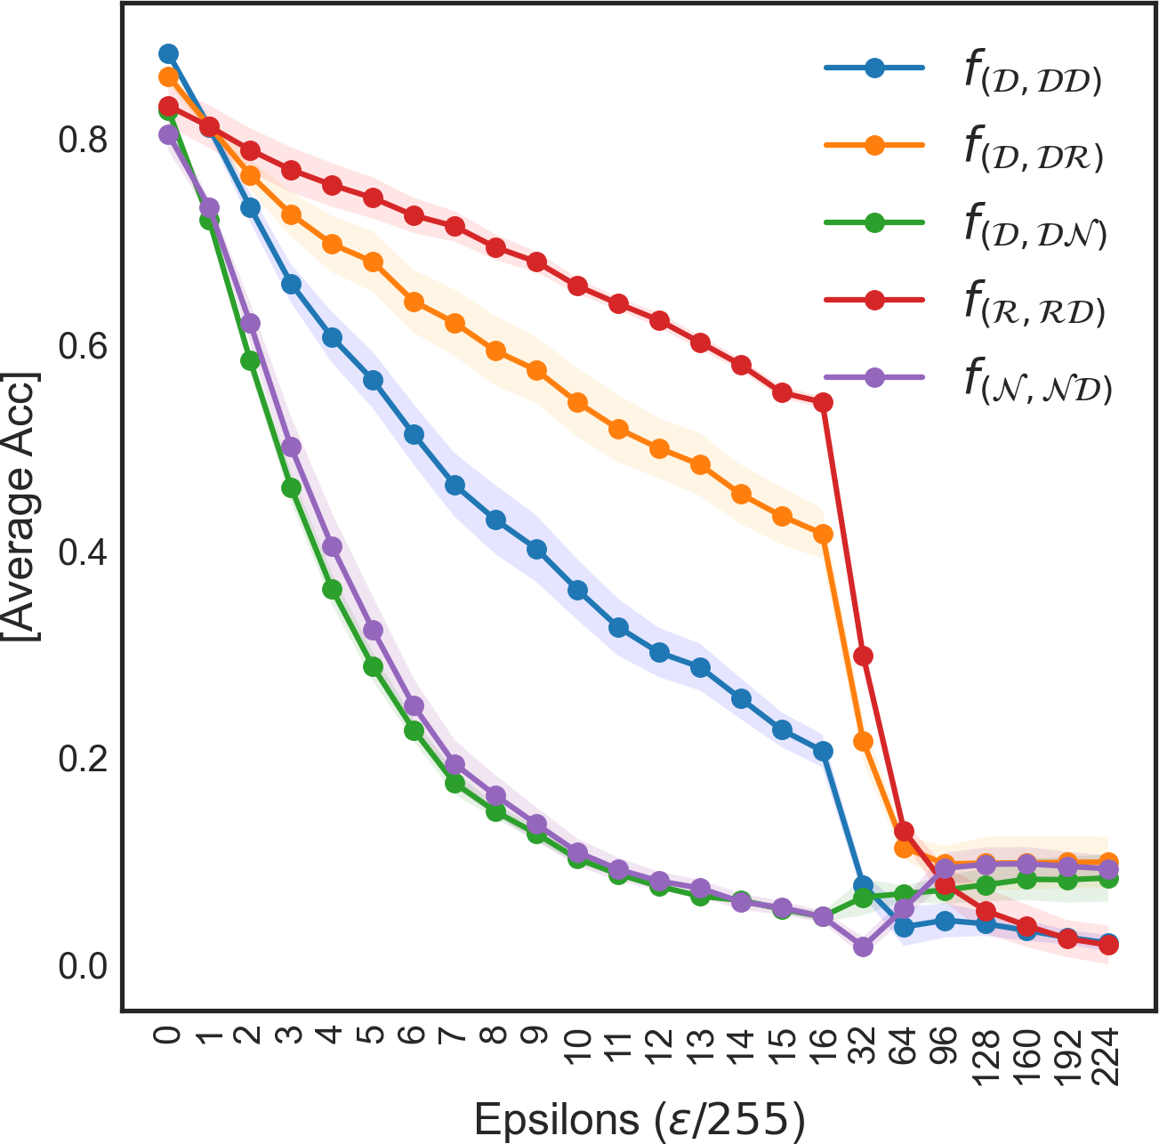
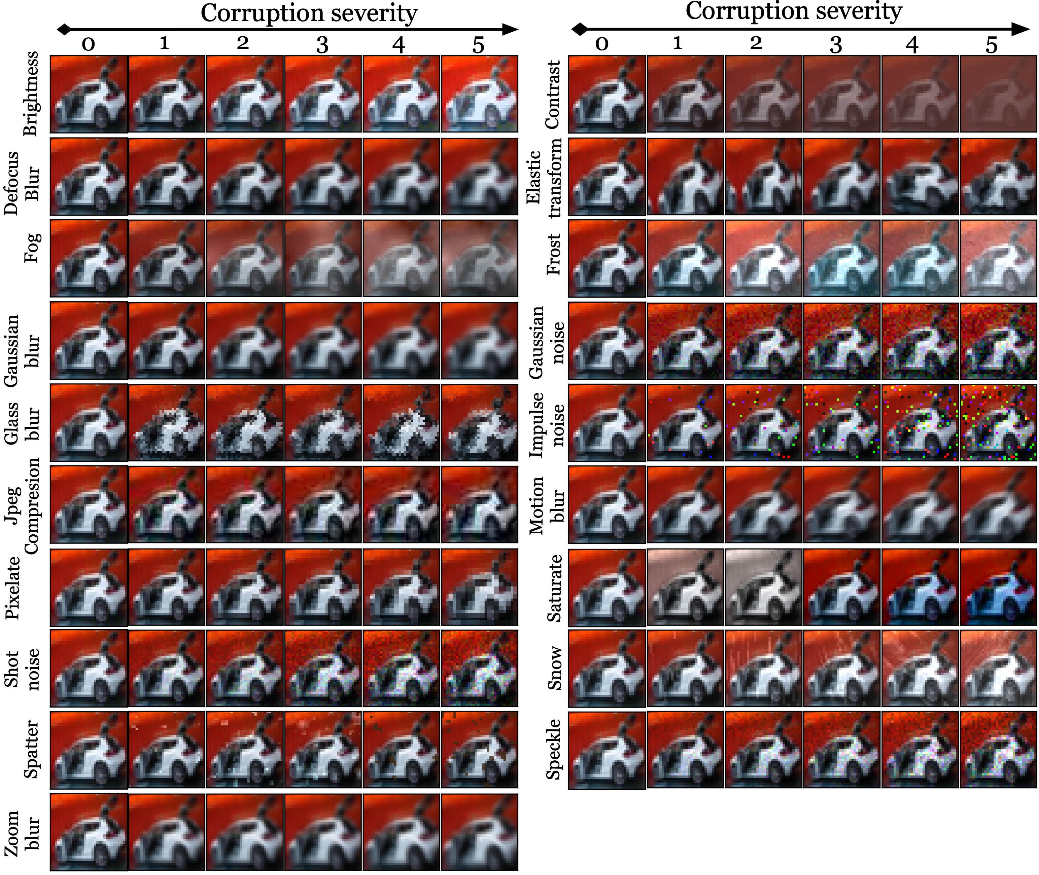
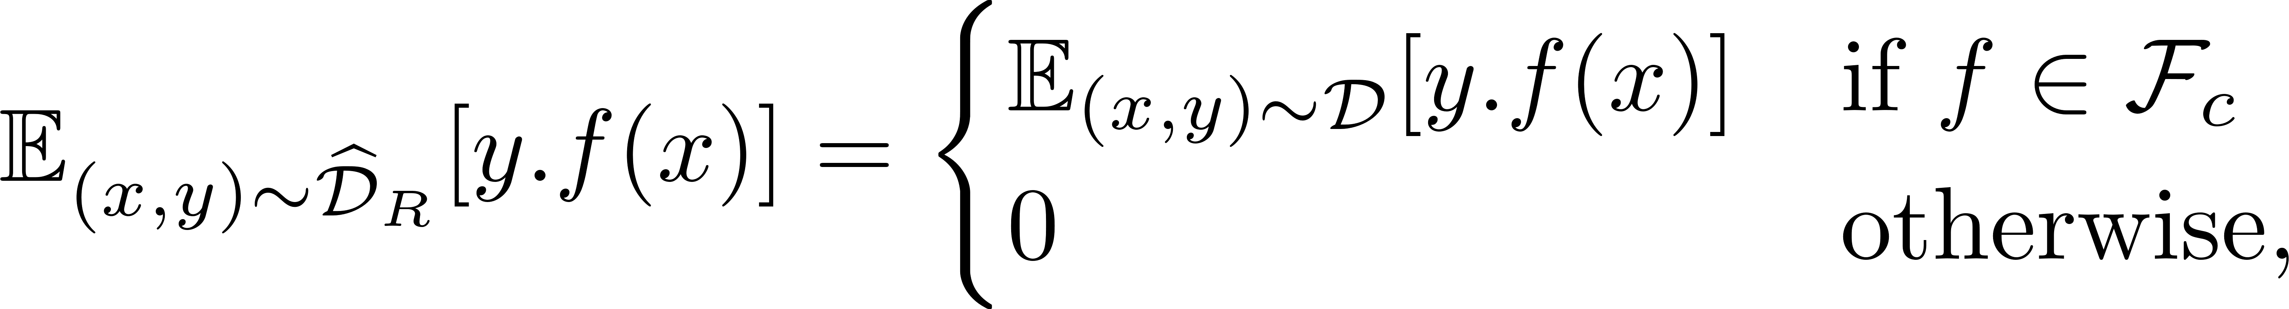


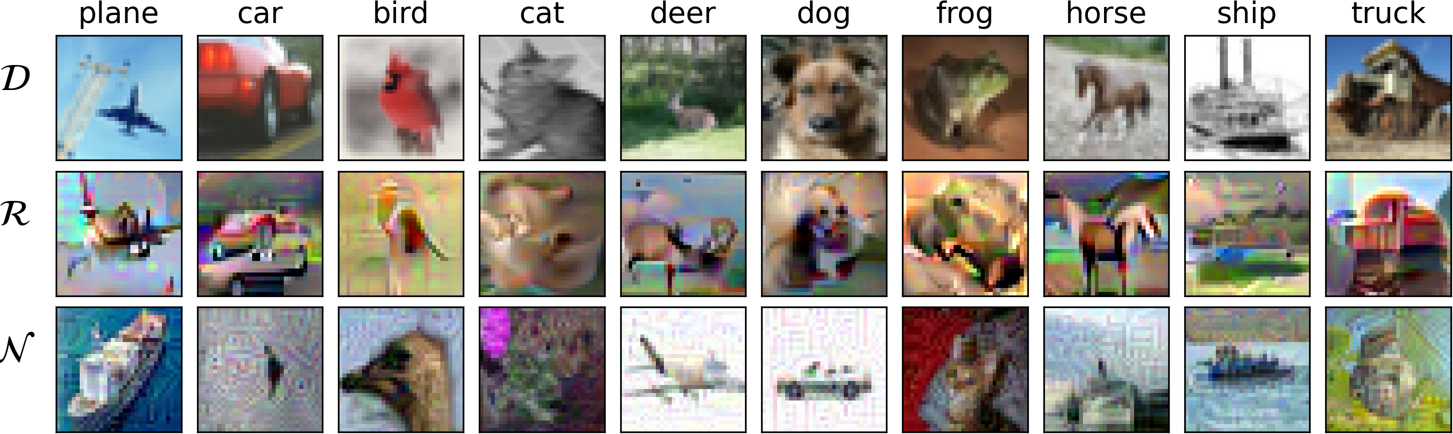
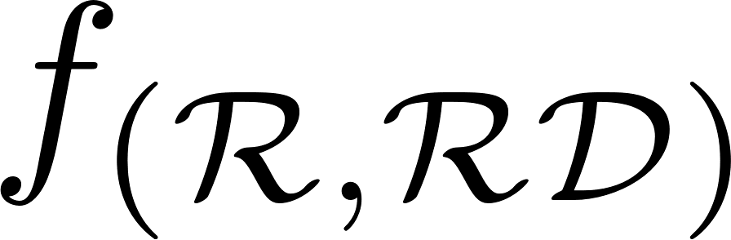
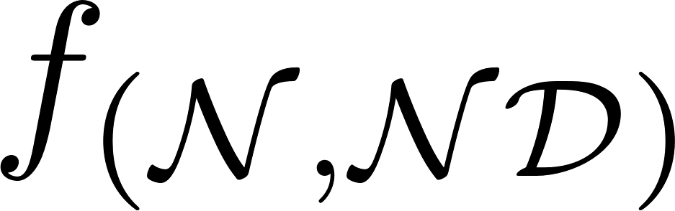
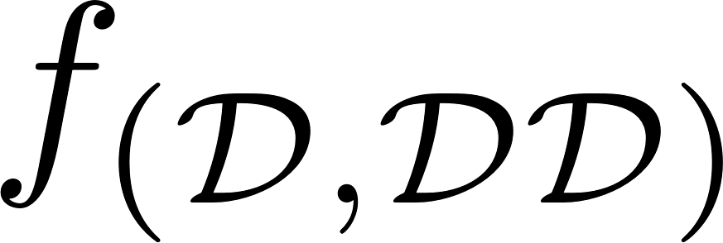
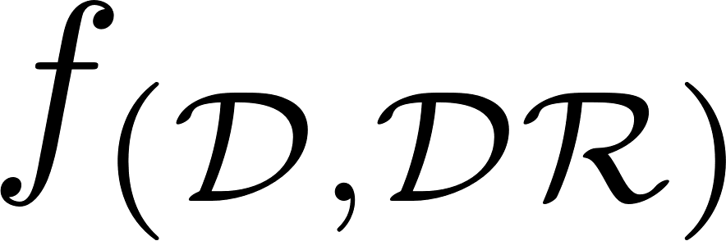
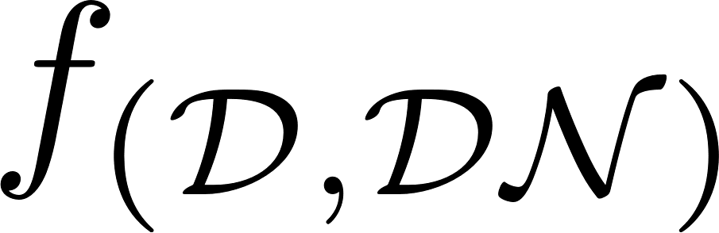
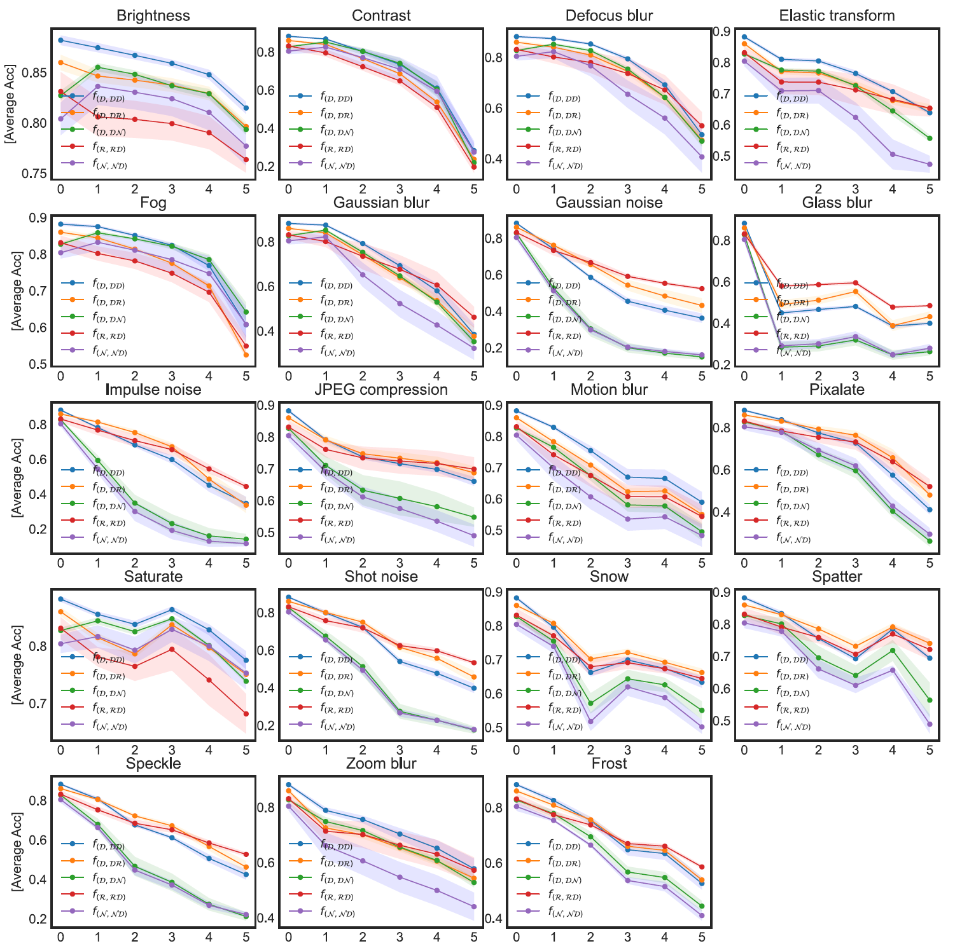
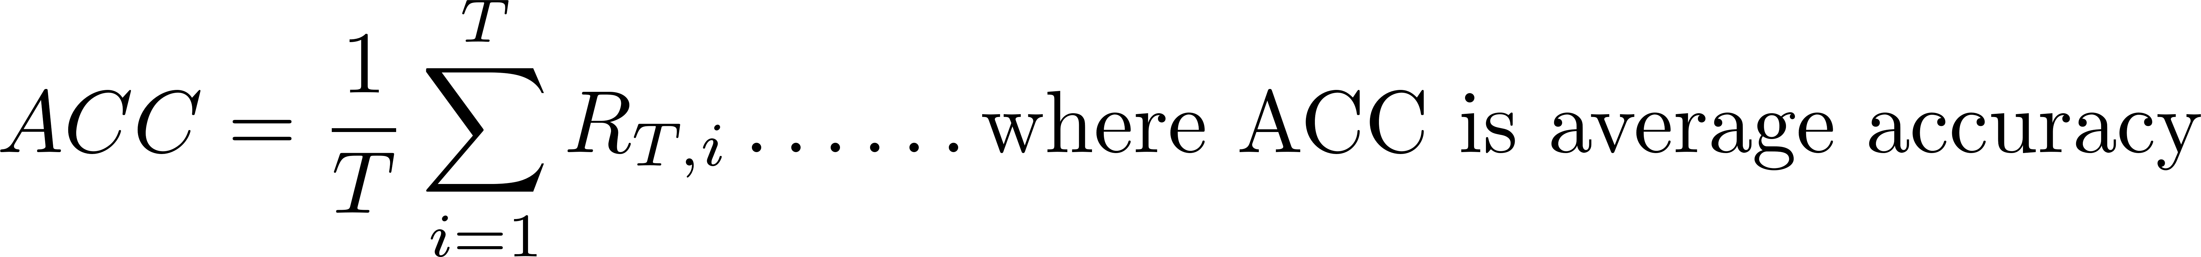
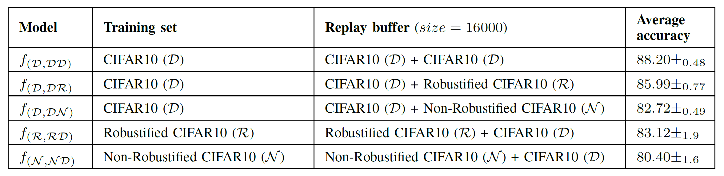
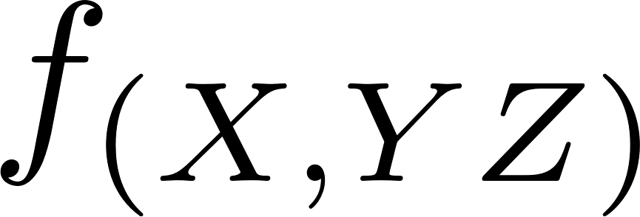
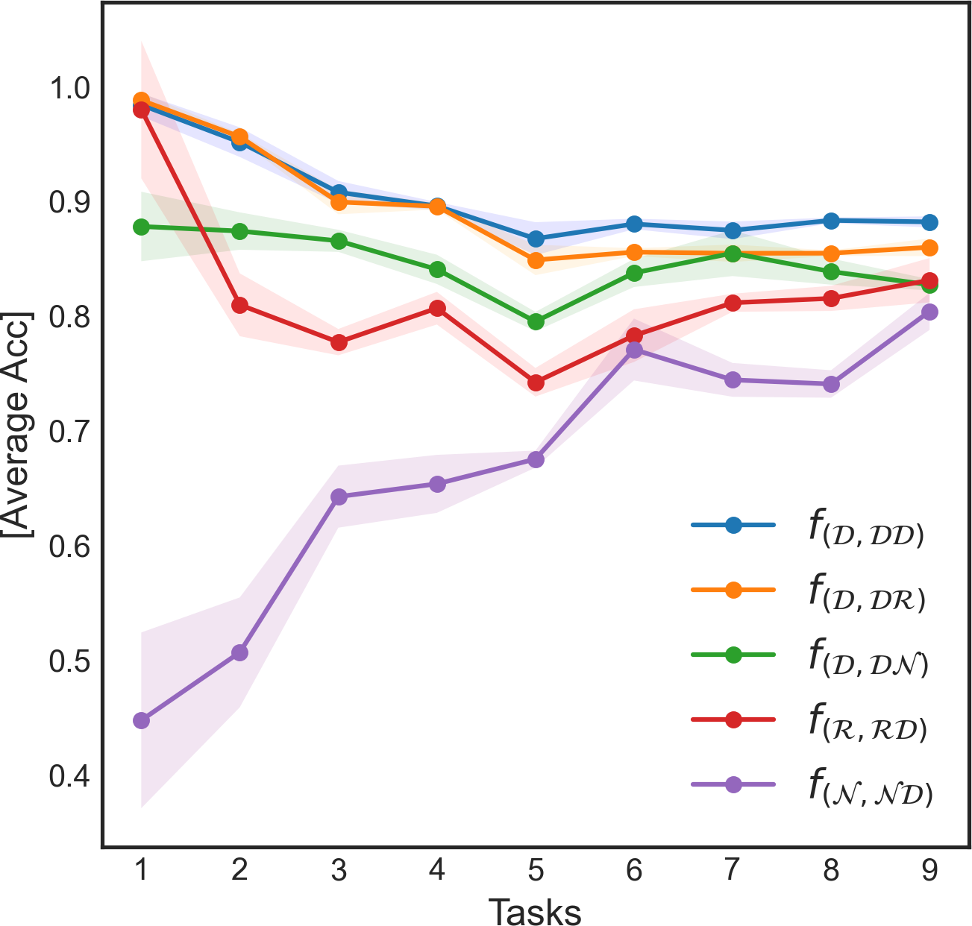
Adversarially Robust Continual Learning
Hikmat Khan • Nidhal Carla Bouaynaya • Ghulam Rasool
Department of Electrical and Computer Engineering, Rowan University, USA
ABSTRACT
EVALUATING ROBUSTNESS AGAINST WORST-CASES ADVERSARIAL PERTURBATIONS
Project Page
Recent approaches in continual learning (CL) have focused on extracting various types of features from multi-task datasets to prevent catastrophic forgetting — without formally evaluating the quality, robustness and usefulness of these features.
This paper presents an empirical study to demonstrate the importance of robust features in the context of class incremental learning (CIL).
The model trained using non-robust features performed the worst in noisy conditions and under adversarial attacks. Our study underlines the significance of using robust features in CIL.
Against FGSM attacks
Against PGD- attacks
Against PGD- attacks
DEFINING USEFUL AND ROBUST FEATURES
Adversarial robustness can be understood by decomposing learned features into robust and non-robust types.
The robust features were used to build robust datasets and shown to increase adversarial robustness significantly.
EVALUATING ROBUSTNESS AGAINST COMMON CORRUPTIONS (CIFAR10-C Dataset)
The average accuracy of the 5 models (i.e. , , , , and against 19 types of noise.
DISENTANGLING ROBUST AND NON-ROBUST FEATURES
Where represents the set of the features utilized by a robust (i.e., adversarially trained) classifier .
1st row: Sample images from standard CIFAR10(D) for all 10 classes. 2nd row: The robustified sample images from robust CIFAR10(R). 3rd row: Samples images from non-robust CIFAR10(N) dataset.
MOTIVATION
There has not been any assessment on using such robust features in CL frameworks to enhance the robustness of CL models against adversarial attacks.
Current CL algorithms use standard features - a mixture of robust and non-robust features - and result in models vulnerable to both natural and adversarial noise.
METHODOLOGY
The average accuracies of all five models trained on CIFAR10, Robustified-CIFAR10 and Non-Robustified CIFAR10 datasets. In the model : the first entry represent the training data set, the second set of letters denotes the replay buffer datasets sampled equally.
The average of the five models , , , and , as the incrementally learn a sequence of 9 tasks in CIFAR10 dataset. Where D=Standard CIFAR10, R=Robustified CIFAR10 and N=Non-Robustified CIFAR10 datasets.
CONCLUSION
We presented an empirical and exhaustive study to demonstrate the crucial role of features in the context of class incremental learning (CIL) under various noise and perturbation environments.
We concluded that continual learning models trained using standard and non-robust features performed poorly in noisy and adversarial conditions as compared to the model trained using robust features.

